Slide 1
MySQL and Redis Exploring Infrastructure Level Database Software
By: Dominick Bucciero and Annie Tao

Slide 2
History
MySQL was initially released in 1995 while Redis was released in 2009
MySQL uses a “relational” approach while Redis uses a “non-relational or NoSQL” approach
Both are used to support major companies with Redis taking over support for many of MySQL’s users
Both are open source
Both value the platforms that make use of their software
Redis’ “Hello World” was called “Retwis” a clone of Twitter which was originally hosted by MySQL
While both software can be used together for even greater results, many choose to compare the software separately

Slide 3
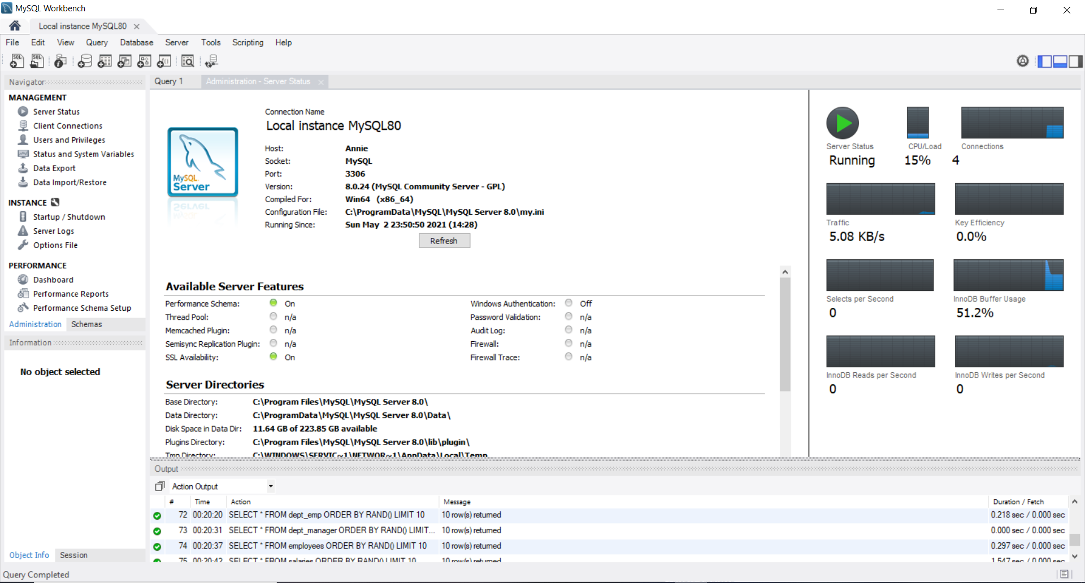
MySQL Setup and Experience
Overall a relatively simple database hosting platform to set up
Uses relational databases
Provides visual diagrams of the database schema
Can host multiple servers at a time
Has performance analysis tools on board through MySQL Workbench
Also has an area to write scripts for the database which can also be saved

Slide 4
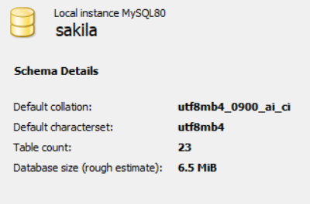
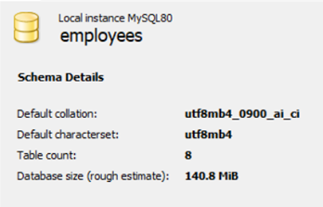
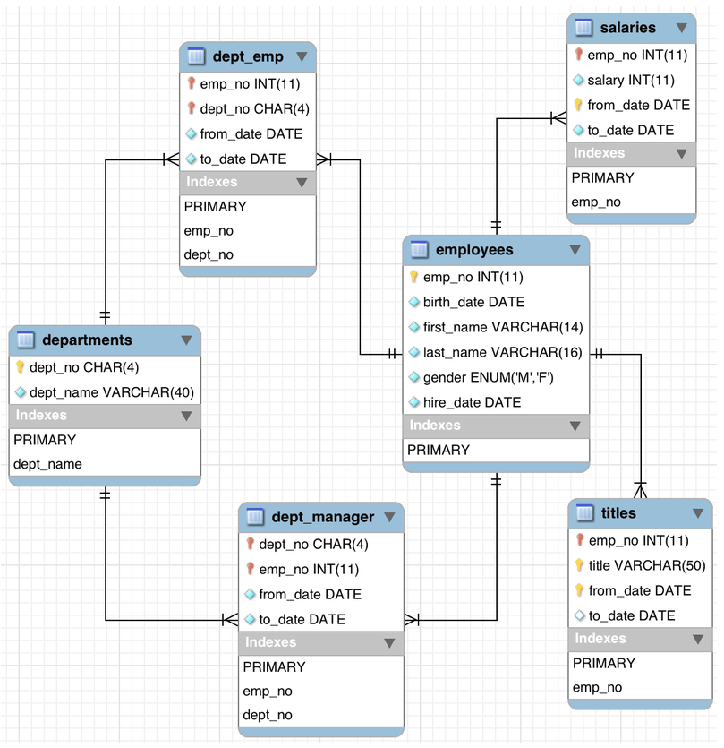
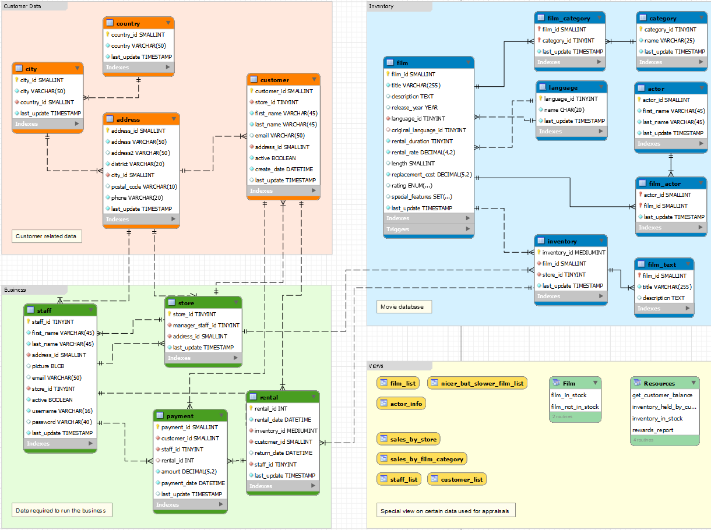
MySQL Analysis
Compared the Sakila Database to the Employees database
Both provided by MySQL for testing and learning
Employees substantially larger to show how workload affects operations
Both were well optimized

Slide 5
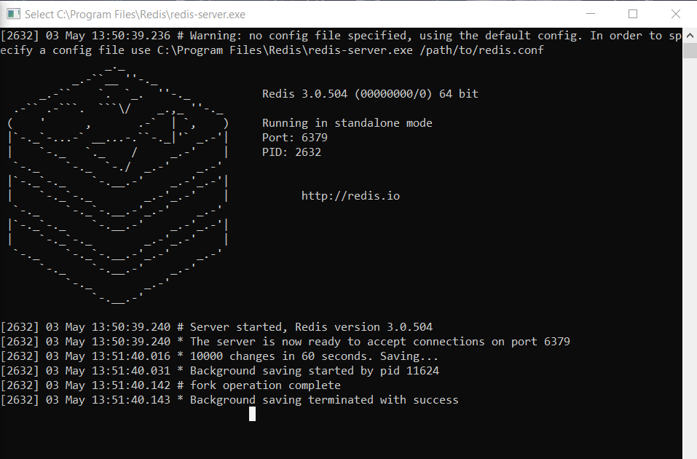
Redis Setup and Experience
Uses non-relational databases
Relatively easy to install
Not supported by windows
Simple to use but hard to visualize given non-relational databases
Not particularly difficult to use as a hosting platform but hard to design for

Slide 6
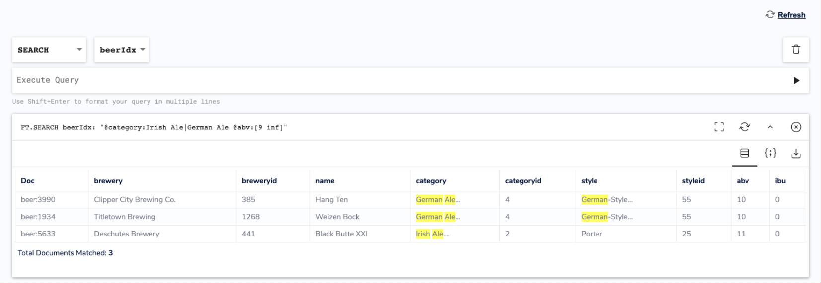
Redis Analysis
Timing scaled slightly better for larger databases
Slightly more difficult to view “expensive” operations
Both were well optimized
Could see where issues could arise but none present in tested databases
Compared the Retwis database to the Openbeer database
Retwis substantially smaller, more of a proof of concept than a full fledged database

Slide 7
Comparison
Both software are capable for any small project
Redis can be a bit tricky but is more rewarding in the long run
MySQL is more forgiving and conceptually easy to understand due to its use of a schema rather than a non-relational database
Redis appears slightly more ambitious in its development as while it can coexist with MySQL it built its platform on taking over or targeting MySQL users

Slide 8
Pitfalls in Relational Design
Selecting more data than needed
Inefficient joins between tables
Too few or too many indexes
Too much literal SQL causing parse contention
Overall PC usage/ network usage
User and query conflicts

Slide 9
Pitfalls in Non-Relational Design
Complexity can become an issue
Consistent JOINS
The lack of structure can be problematic
Collaboration can be tricky

Slide 10
Our Review - Which fits your project?
MySQL and Redis are effectively as efficient for smaller projects
MySQL is less complex and more conceptually easy to understand
Redis scales more efficiently
Redis can be more complex especially when collaborating
Both are suitable for almost any size project
Both are open source
MySQL appears to have more documentation and guides online

